Slide 1
Predicting Mortality of Patients Admitted into the ICU
Group 1:
Jack Johnson
Mohit Ramnani
Trong Shen
Wendy Tran
Flora Wan
Notes:
Hi everyone, this is Group 1, and our project is on "Predicting Mortality of Patients Admitted into the ICU"

Slide 2
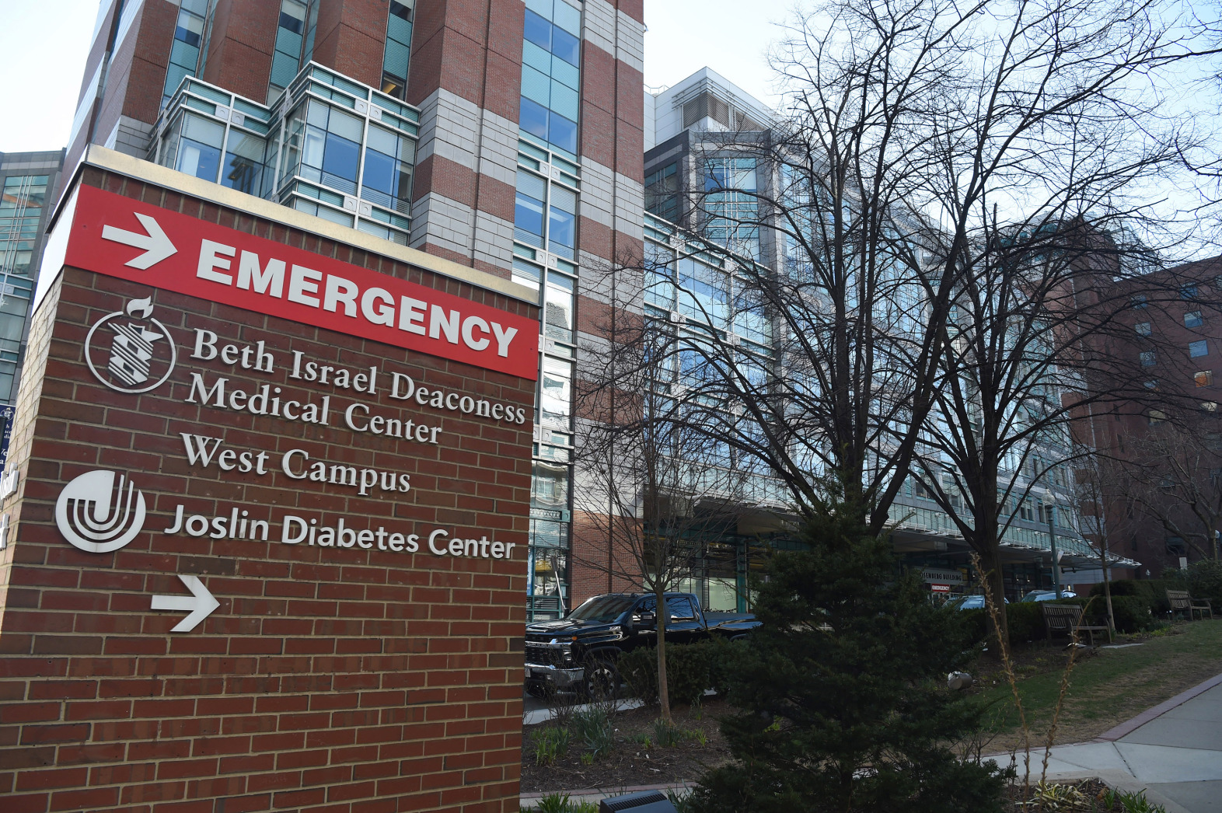
background
objectives
methodology
results
challenges
Lessons
learned
Notes:
Beth Israel Deaconess Medical Centre is a large hospital in Boston, MA. It employs more than 4,000 doctors and provides a range of emergency services.

Slide 3
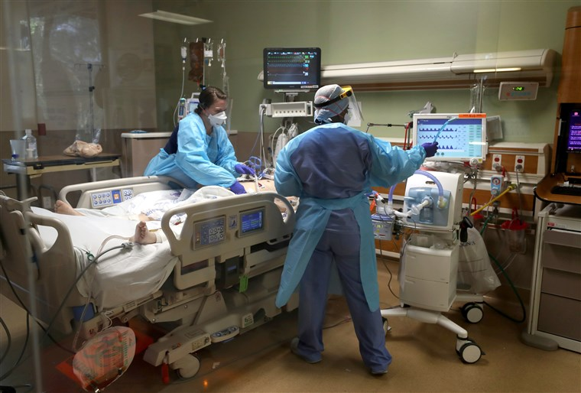
background
objectives
methodology
results
challenges
Lessons
learned
Notes:
Currently, doctors in the ICU oversee a lot of patients and in order to make a judgement on the severity of a patient’s diagnosis, the doctor has to review the output of many different machines that are monitoring the patient’s vital signs as well as lab results and other information entered into the hospital’s electronic medical record (EMR) system. This is both inefficient and costly, and because this is a manual process, doctors may even inadvertently overlook certain patients that are actually at high risk.

Slide 4
background
objectives
methodology
results
challenges
Lessons
learned
Electronic Medical Records (EMR)
AI Model
Predict Risk of Mortality (Death)
ICU Patient Data
Notes:
So the aim of our project is to use the routine data that is collected electronically on each patient admitted into the ICU to build an AI model that can accurately predict their risk of mortality.

Slide 5
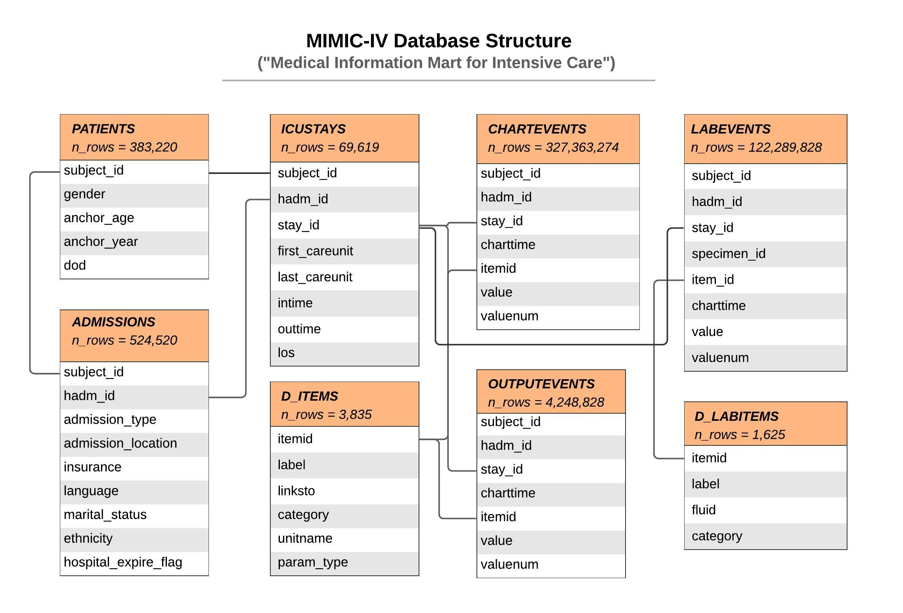
background
objectives
methodology
results
challenges
Lessons
learned
Notes:
The data in our project came from the MIMIC database. This database provides de-identified data for over 50,000 ICU patients at the Beth Israel Deaconess Medical Center.
MIMIC is structured as a relational database consisting of many related tables. Each table was provided to us as a separate CSV file that are linked together through unique identifiers.
(click) Our target variable for this supervised classification problem is the “hospital_expire_flag”, which is a binary variable indicating if the patient survived until hospital discharge (0) or died during their stay (1).

Slide 6



background
objectives
methodology
results
challenges
Lessons
learned
ADMISSIONS
ICUSTAYS
Manual scoring systems (SAPS-II, APACHE)
Retired ICU nurse
Source Data
CHARTEVENTS
OUTPUTEVENTS
LABEVENTS
admission_type
admission_location
insurance
language
marital_status
ethnicity
target = mortality*
*hospital_expire_flag
age
first_careunit
heart_rate
systolic_blood_pressure
body_temperature
PaO2_FiO2
respiratory_rate
O2_saturation
central_venous_pressure
glucose_finger_stick
hemoglobin
foley
void
condom_cath
ileoconduit
suprapubic
nephrostomy
straight_cath
ureteral_stent
gu_irrigant
urea_nitrogen
bicarbonate
arterial_ph
wbc_count
creatinine
hematocrit
sodium_level
potassium_level
bilirubin_level
Selected Features
Notes:
To select the features for our model, (click) we first looked at the ADMISSIONS and ICUSTAYS tables which contain information such as the patient’s age and demographics, and what type of hospital unit they stayed in. (click) We also extracted our target variable ‘hospital_expire_flag’ from the ADMISSIONS table and renamed it to “mortality”.
However, since we’re trying to predict the outcome of a patient’s health condition, the most important features would actually be the physiological measurements and vital signs that are collected from each patient during their stay. In order to select which of these physiological measurements are most relevant for our predictive model, (click) we looked at several of the most commonly used manual scoring systems that predict mortality in ICUs and also talked to a retired ICU nurse to get her perspective on what are some of the most important things she would look for in a patient to determine their severity. From these sources of expert opinion, (click) we came up with a list of features to be extracted from the database and engineered two variables for each feature using its mean and standard deviation from the first 24 hours of a patient’s stay in the ICU. The mean value provides a consistent measurement of each patient’s vital signs over a period of time, and the standard deviation shows how much these vital signs are fluctuating, both of which are important indicators as to the overall condition of the patient’s health.

Slide 7
background
objectives
methodology
results
challenges
Lessons
learned
subject_id | stay_id | age | admission_ type | heart_rate_mean | heart_rate_std | … | mortality
17823467 | 35964304 | 74 | EW EMER. | 70.12 | 8.26 | … | 0
13173210 | 38210858 | 66 | ELECTIVE | 83.37 | 11.87 | … | 0
17609946 | 36688459 | 70 | OBSERVE | 106.78 | 9.63 | … | 1
17038041 | 33606076 | 47 | URGENT | 73.28 | 7.75 | … | 0
12570801 | 39645373 | 67 | EW EMER. | 96.07 | 9.06 | … | 1
10546500 | 38895284 | 44 | SURGICAL | 102.33 | 5.21 | … | 0
15772648 | 26147926 | 56 | EW EMER. | 78.92 | 18.84 | … | 0
19321668 | 34784165 | 67 | DIRECT EMER. | 109.14 | 15.39 | … | 1
Notes:
Putting it all together, we merged the features that we’ve extracted from the database into one CSV file where each row represents a unique stay for a patient in the ICU and each column represents a predictor for the target variable of mortality.

Slide 8

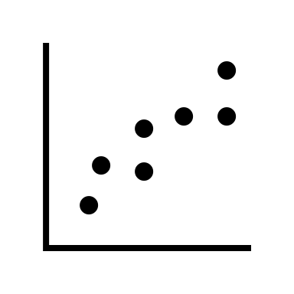
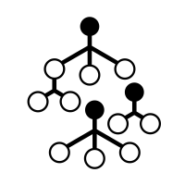

background
objectives
methodology
results
challenges
Lessons
learned
Missing Data
Transformation Pipeline
87
EMER
98.4
47
NaN
102.5
MinMaxScaler()
65
URG
NaN
51
71
84
0.392
0.631
0.785
TRAIN
(80%)
X_train.shape (38426, 41)
Outliers
Dataset
OneHotEncoder()
UNIT
Surgical
Trauma
UNIT_ Surgical | UNIT_ Trauma
1 | 0
0 | 1
TEST
(20%)
X_test.shape (9610, 41)
Multicollinearity
FeatureSelector()
1 | 0.3 | 0.1 | 0.8
0.2 | 1 | 0.6 | 0.3
0.2 | 0.3 | 1 | 0.5
0.1 | 0.1 | 0.2 | 1
Feature Importance
ExtraTrees
Notes:
Looking at the dataset that we had put together, we first did some exploratory data analysis and data cleaning to take care of missing data, outliers and collinearity between variables.
The cleaned dataset was then split into train and test sets and fed through a transformation pipeline where numerical variables were scaled, categorical variables were one-hot encoded, and a custom feature selector method was used to select the top 50% of predictors that ranked the highest in terms of feature importance.
This resulted in 41 features, with about 38,000 records in the training set and 9600 in the test set.

Slide 9
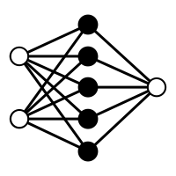

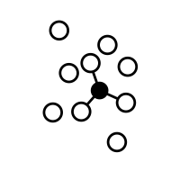
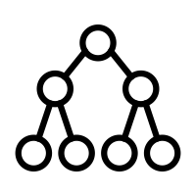

background
objectives
methodology
results
challenges
Lessons
learned
Logistic Regression
K-Nearest Neighbors
Random Forest
MLP Classifier
Simple
Complex
Decision Tree
Support Vector Machine
XGBoost
TF/Keras
Neural Network
Notes:
Using the training set, we trained 8 different classification models and performed hyperparameter tuning on each one to improve on its base performance. We chose a variety of different algorithms in order to compare the performance of simpler models such as logistic regression and decision tree with more complex models like random forest, XGBoost and neural network.

Slide 10
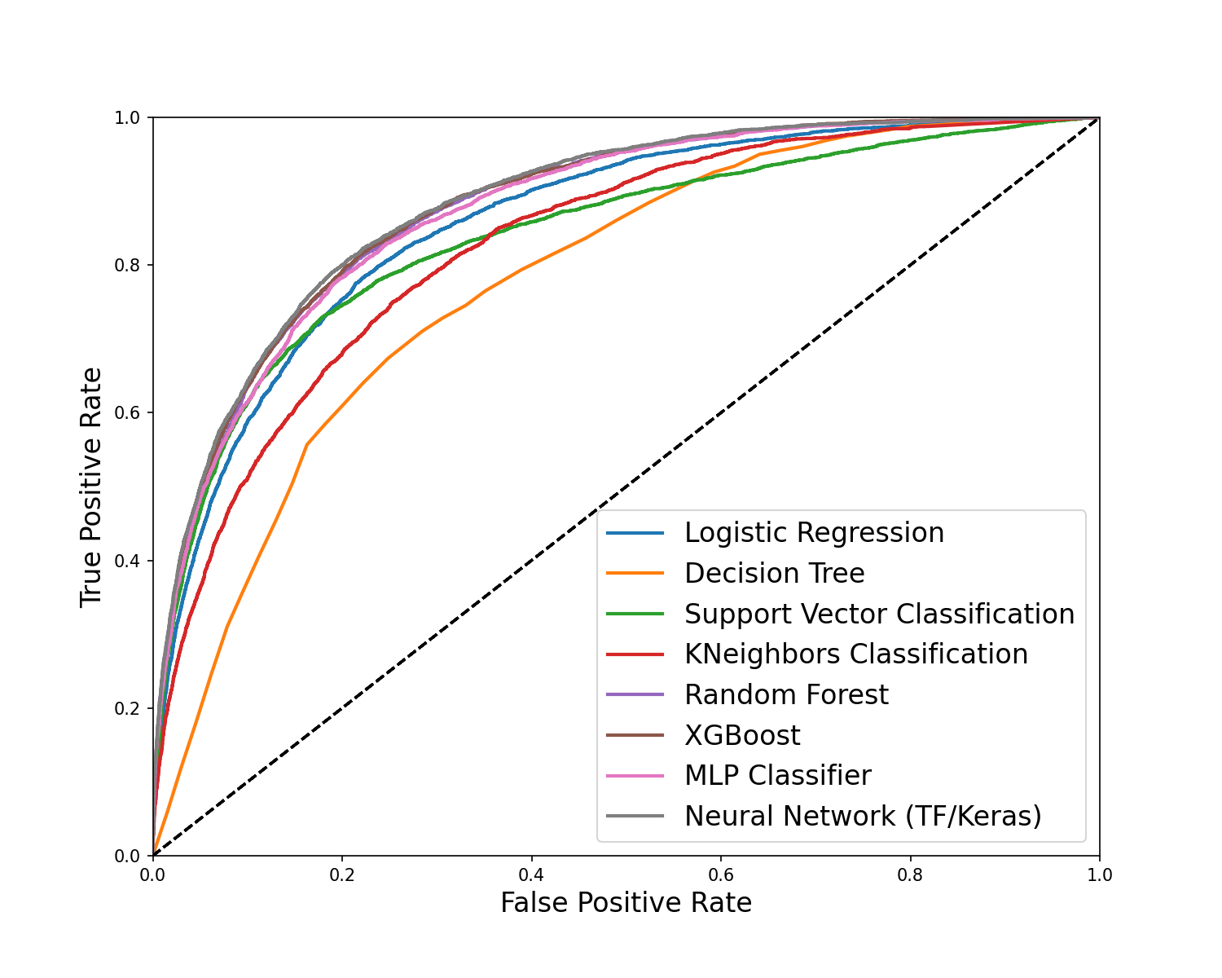
background
objectives
methodology
results
challenges
Lessons
learned
AUC = ~0.88
Notes:
Looking at the resulting plot of the ROC curves for each of the models, we see that several models have similarly good performance (click), including random forest, xgboost, and the two neural networks -- one which was created through Keras and Tensorflow, and the other using MLP classifier, which is the sci-kit learn implementation of a neural network.

Slide 11
background
objectives
methodology
results
challenges
Lessons
learned
Random Forest
MLP Classifier
Stacking Ensemble
XGBoost
Final Prediction
MLP Classifier
Final Estimator
* threshold = 0.5
Model | ROC-AUC | Accuracy* | Precision* | Recall* | F1 Score*
Stacked Ensemble | 0.885 | 0.915 | 0.67 | 0.31 | 0.43
Neural Network | 0.882 | 0.914 | 0.65 | 0.33 | 0.44
XGBoost | 0.879 | 0.913 | 0.66 | 0.29 | 0.41
MLP Classifier | 0.879 | 0.912 | 0.64 | 0.29 | 0.40
Random Forest | 0.878 | 0.911 | 0.78 | 0.18 | 0.29
Notes:
To try and further improve the performance of our model, we used the stacking ensemble technique to test out different combinations of base models and meta-classifiers. In the end, the combination of the random forest, xgboost and MLP classifier models with another MLP classifier as the final estimator resulted in the best AUC score of .885, which is overall greater than any of our individual models.
Therefore, we decided to choose the stacked ensemble as our final model.

Slide 12
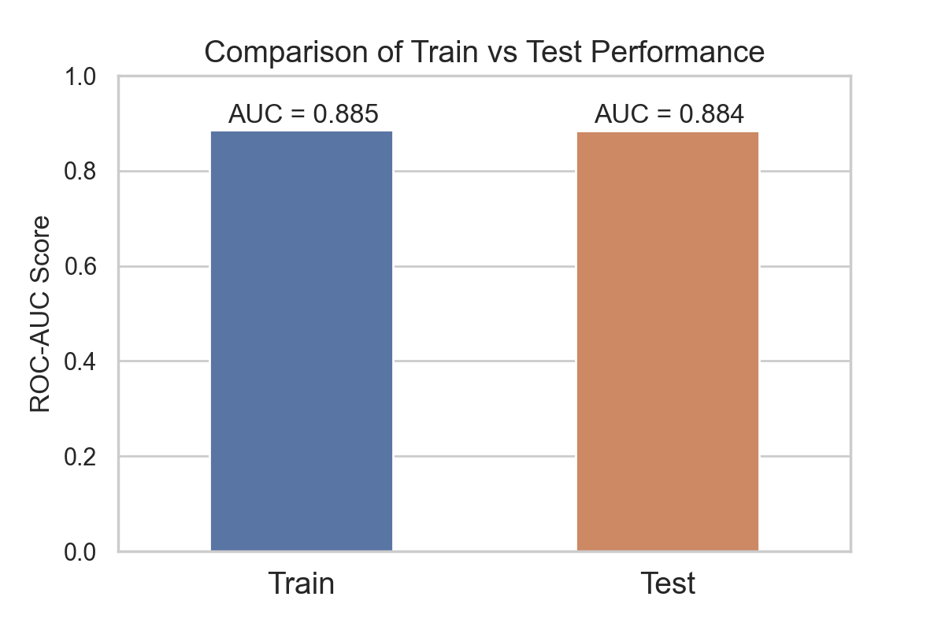
background
objectives
methodology
results
challenges
Lessons
learned
Notes:
We then tested the model’s predictions against the test set and found that the AUC score of the test set is .884, (click) a different of only 0.1% compared to the results of the training set, showing that the performance of our model is indeed generalizable to unseen data.
So now that we have built this machine learning model, how can it be used in an actual ICU?

Slide 13

background
objectives
methodology
results
challenges
Lessons
learned
Risk Score History
Risk Score: 0.67
1.0
Patient ID: 2856346
Patient name: Smith, John
Age: 58
Admission Type: URGENT
Care Unit: Trauma ICU
0.8
0.6
Risk Score
0.4
0.2
Last Updated: 2020-04-07 17:45
0
Time
Current Heart Rate: 80 bpm
Current Temperature: 102.5 F
Current Blood Pressure: 132 mmHg
140
103
160
120
101
140
bpm
Fahrenheit (F)
mm Hg
100
99
120
80
97
100
60
95
80
Time
Time
Time
80 bpm (Normal)
102.5 F (High)
132 mmHg (Warning)
Notes:
Well, imagine that you can create an app that interfaces with the hospital’s EMR system. For each patient, the doctor can pull up their record and see the real-time risk score (click) that is calculated by our AI model, which is the probability that the patient may die based on their current vital signs and lab results, all of which are automatically extracted from the EMR. (click) In addition, the doctor can also see a history of the risk scores over time to determine whether that patient is getting better or worse.
The decision on when to alert the doctor depends on the threshold that is set for the risk score.

Slide 14
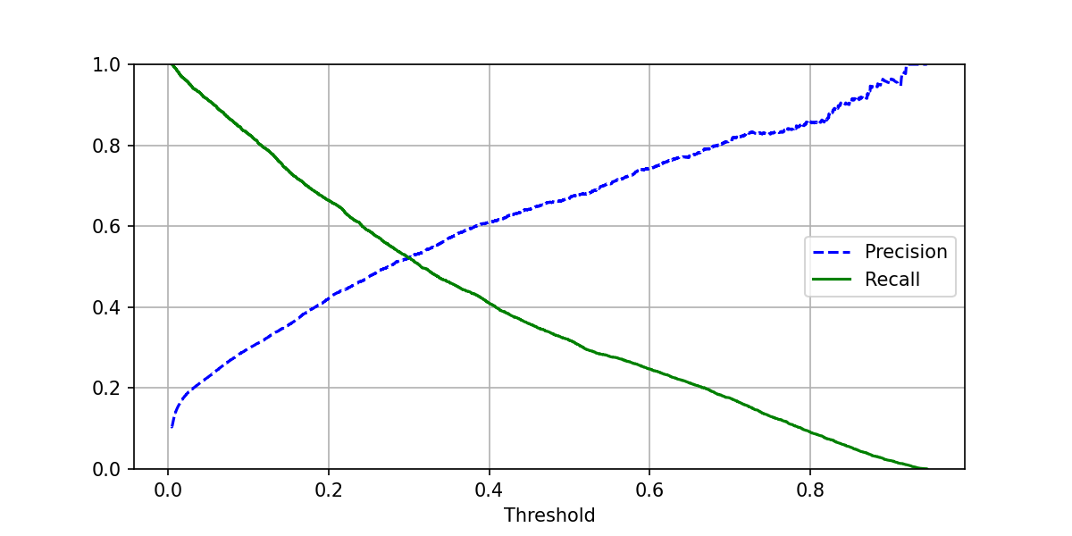
background
objectives
methodology
results
challenges
Lessons
learned
Risk Score History
Risk Score: 0.67
1.0
Patient ID: 2856346
Patient name: Smith, John
Age: 58
Admission Type: URGENT
Care Unit: Trauma ICU
0.8
0.6
Risk Score
0.4
Threshold = 0.1
0.2
Last Updated: 2020-04-07 17:45
0
Recall value: 0.82
Time
Current Heart Rate: 80 bpm
Current Temperature: 102.5 F
Current Blood Pressure: 132 mmHg
140
103
160
120
101
140
bpm
Fahrenheit (F)
bpm
100
99
120
80
97
100
Precision value: 0.29
60
95
80
Time
Time
Time
80 bpm (Normal)
102.5 F (High)
132 mmHg (Warning)
Notes:
If the threshold is set lower, this would increase the recall value so that doctor will be warned about more patients that may be at risk, but this may cause “alert fatigue” if doctors are notified too frequently.

Slide 15
background
objectives
methodology
results
challenges
Lessons
learned
Risk Score History
Risk Score: 0.67
1.0
Patient ID: 2856346
Patient name: Smith, John
Age: 58
Admission Type: URGENT
Care Unit: Trauma ICU
0.8
0.6
Risk Score
0.4
0.2
Threshold = 0.7
Last Updated: 2020-04-07 17:45
0
Time
Precision value: 0.81
Current Heart Rate: 80 bpm
Current Temperature: 102.5 F
Current Blood Pressure: 132 mmHg
140
103
160
120
101
140
bpm
Fahrenheit (F)
bpm
100
99
120
80
97
100
Recall value: 0.17
60
95
80
Time
Time
Time
80 bpm (Normal)
102.5 F (High)
132 mmHg (Warning)
Notes:
On the other hand, if the threshold is set higher, this would increase the precision value which would mean that more patients may be missed by the warning system but when doctors *are* alerted, it’s an indication that this is a very severe case that requires immediate attention. Ultimately, the decision on what threshold to use would have to be based on consultation with the doctors and nurses in the ICU to make sure that the alert system fits in with their workflow.
So this is how we envision that our AI model can be integrated and deployed in a hospital setting to make a difference in the quality of care for patients.

Slide 16
background
objectives
methodology
results
challenges
Lessons
learned
Understanding the MIMIC relational database structure
Large table sizes e.g., CHARTEVENTS (273 million records, 27GB size)
Selection of features
Based on expert opinion
Collected frequently
Not highly correlated to other features
Notes:
In term of challenges we encountered during the project, many were related to feature engineering.
Because MIMIC is a relational database, we had to first understand the table structure and how each table relate to each other, and then find out whether the features we’re looking for were even collected and if so, where they were stored. Furthermore, some of the tables were huge – as an example, the chartevents table that records all the physiological measurements for each patient has 273 million records and is 27GB in size. So it was quite a challenge to load in this table and filter it down to the records we’re interested in. Another challenge was in selecting what features to include. Since none of us came from a science background, we had to do a lot of research to make sure that the features we’re selecting are ones that are important predictors based on expert opinion, collected frequently enough during each patient’s stay, and also not highly correlated to other variables in the dataset.

Slide 17
background
objectives
methodology
results
challenges
Lessons
learned
Good experience working with realistic healthcare dataset
Importance of feature engineering
Using mean and standard deviation to represent physiological measurements
How AI model can make an actual impact in the real-world
Notes:
For lessons learned, we thought it was a really good experience being able to work with a healthcare dataset that is structured very similarly to a real EMR system in a hospital. Throughout this process, we learned the importance of feature engineering and ways to make decisions about what features to select or transform. We also came up with the idea of using the mean and standard deviation to represent each of the physiological measurements which is an interesting use of mathematics to approach a scientific study. Finally, we learned that it’s important to have an end goal in mind on how an AI model can be deployed to make an actual impact in a real-world setting.

Slide 18

background
objectives
methodology
results
challenges
Lessons
learned
Questions?
Notes:
So that is it for our presentation, we’re happy to take any questions or comments from the class.

